Slide 1
NIIT PROJECT PRESENTATION
BY:- AYUSH BANSAL
Topic-The Jukebox

Slide 2

The JUKEBOX
What is a JukeBox?
A jukebox is a partially automated music-playing device, usually a coin-operated machine, that will play a patron's selection from self-contained media. The classic jukebox has buttons, with letters and numbers on them, which are used to select a specific record. Some may use compact discs instead.

Slide 3
Features of JukeBox
The features of jukebox are classified into three parts:-
1-Songs
2-Playlist
3-Player

Slide 4

Songs
Designing a jukebox that contain songs by various artists.
Display all songs.
Add different genres of music to catalog.
Catalog can be categorised on basis of:-
1- Song name
2- Artist name
3- Genre

Slide 5

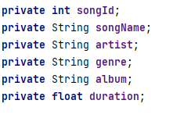
Songs- Model Class
Songs class will have some attributes which are private as access
specifiers and have different datatype accordingly.
The class will have a parameterised and a non parameterised constructor.
There would be getters and setters for all attributes.
It will also have toString() method.
songId
duration
songName
genre
artist
album

Slide 6
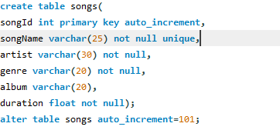
Songs table in database
A table in a database is required to store songs in database.
Columns of table will be exactly same as attributes of songs class.
SongId attribute is set to be auto_increment to automatically increase the song id as a new song is inserted in database.

Slide 7
How to fetch data of songs from the database ?
Is it feasible to fetch the data from the database in java program for every method every time?
Every time fetching the data from database make the program slow and it is a costly process in real time project.
So it is beneficial to store all the song data from database in an ArrayList at once and use the arrayList in all methods.

Slide 8
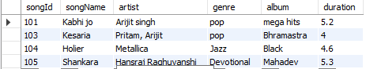
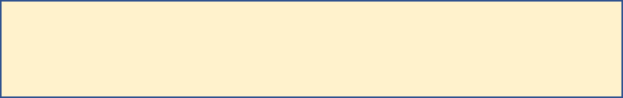
Phenomenon
In Main()
Declare an arraylist name allSongs;
Call the getAllSongs method.
This method will return an ArrayList of songs
Store this ArrayList in allSongs list.
Songs constructor
new Songs()
Song objects
101
102
103
104

Slide 9
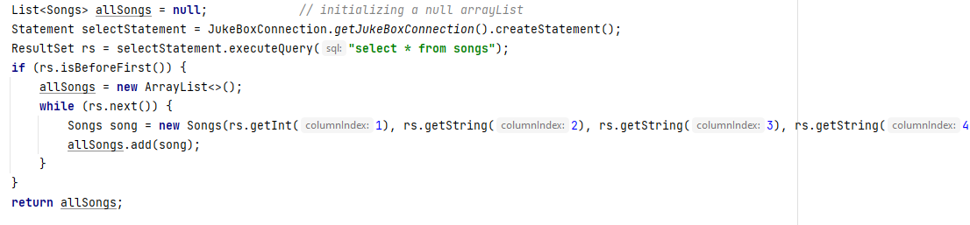
Method to fetch data from database
The getAllSongs method returns an ArrayList of song object.
All the data can be seen from database by throwing a query
Steps
1- Declare a null list 2-Execute the ‘select * from songs ; ‘query.
3-Get one by one song data. 4-Create a song object by using ResultSet.
5- Add the song in allSongs List.

Slide 10
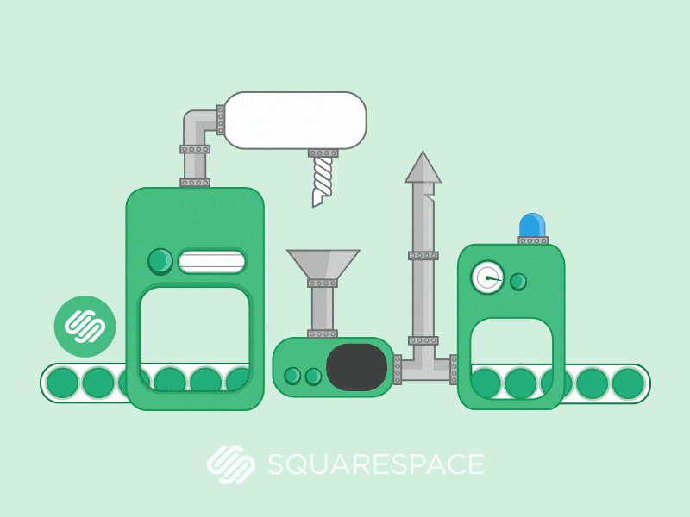

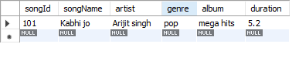

Phenomenon- Adding song into songs table of jukebox database
insertSong method
Ask user for different songs attributes by using scanner.
Store all values in different variables.
Create an object of songs class.
output
input
Song attributes
Call insertSong method and pass the songs object in it.
It will insert all the attributes of song in the database.
Note:- Every time, when we add a new song in database, we have to update the allSongs listby:
allList=getAllSongs();

Slide 11
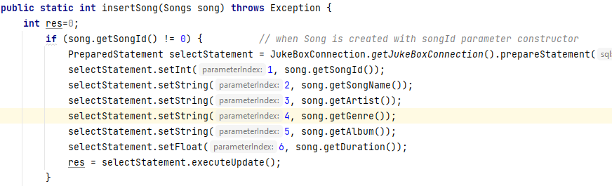
Method to add Songs in database
Create a method which take songs class object as input and pass query to database to insert the song in songs table.

Slide 12
Categorised search
Song can be searched by category:-
1- Song name
2- Artist name
3- Genre

Slide 13
Phenomenon
Catogarized list
songName/album/artist
101
103
get_song_by_category
method
allSongList
101
102
103
104
Currentsong.getAlbum/song/artist==album/song/artist
Condition check
103
101

Slide 14
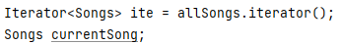
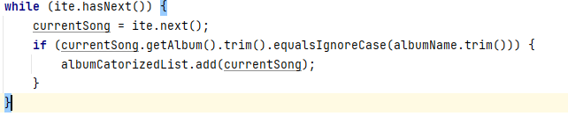
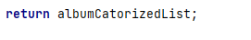
Method code
Now we have an ArrayList of Songs(allSongs) so, it is not required to call database again.
Get the input from user for –songName/artist/albumName.
Declare a new arrayList of songs-songList.
To search/get the song, we can iterate through allSongs list.
Iterate over the allSongs by using an iterator and search whether the
element in list matches the input .
Add the song in songList.
Return songList.

Slide 15


Playlist Content
Playlist
Display all playlists.
Create new playlist
View songs in a playlist
Add songs to playlist.
Add album to playlist.

Slide 16
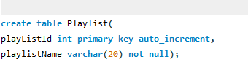
Create table playlist in Database
A playlist table in a database is required to store name of created playlists.
It will have playListId and playlist name.
playListId attribute is set to be auto_increment to automatically increase the playlist number as new playlist is created.

Slide 17
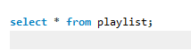
How to fetch data of playlists from the database ?
Similar as songs it is not feasible to fetch the data of playlist from the database.
So at this time, we will use a Hash Table of java to store playlistId and playlistName.
Playlist name will be key
Playlist Id will be value of hash table.
The getAllPlaylist() method returns an HashTable having playlistname and playlistId.
All the data can be seen from database by throwing a query
Steps
1- Declare a new hashTable- all Playlist 2-Execute the ‘select * from playlist ; ‘query.
3-Get one by one playlist data by ResultSet. 4-use hashTable’s put method to insert all values in allPlaylist. 5- Return allPlayist.

Slide 18
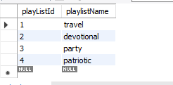
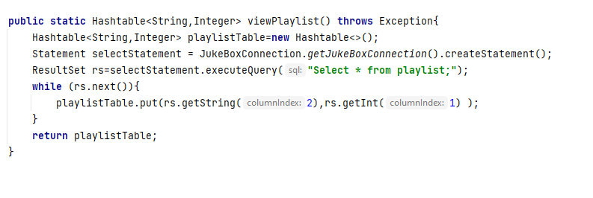
Code
Keys
Values
travel
1
devotional
2
party
3
patriotic
4

Slide 19
How to Create new playlist
To create a new playlist, first we have to check if the playlist name is exist or not.
If it is not ,create new playlist.
For this we have to take input by user for new playlist name.
Simplu,Pass a query
This will create new row of new playlist
insert into playlist(playListName) values(playlistName);")

Slide 20
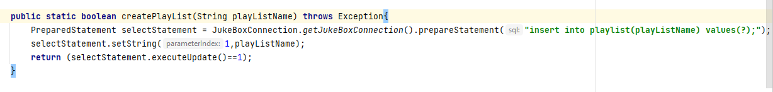
Code for new playlist

Slide 21
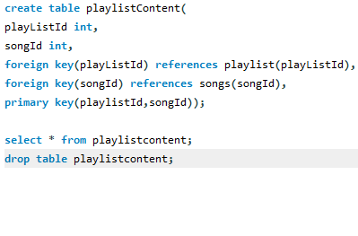
PlayList Content
For storing songs in a playlist, we have to create a link for playlist and Songs.
For this we have to create a table playlistContent ,make two columns-playlistId and SongId.
and set both columns primary key together.
This pair of both ids should be unique so that there would not be repetition of insertion of songs
For example
playlistId
songId
1
2
1
1
2
3
3
1

Slide 22
Get song in a playlist
playlistId
songId
1
102
Firstly declare a new arrayList of integer for songId.
To find the song in a playlist we have to write a query
"Select songId from playlistContent where playlistId=?;");
This will return all the songId for the required playlistId
By using Resultset add all the songId in the ArrayList.
Return this songId list.
1
101
2
103
3
101
1
105
Example for playlist id 1
102
101
105

Slide 23
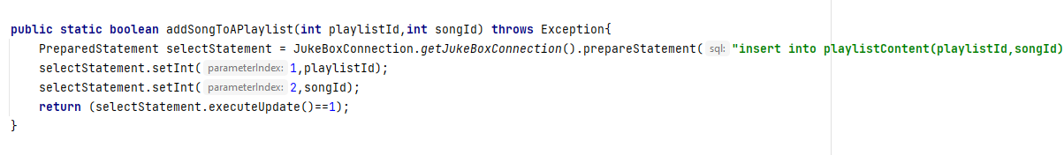
Add song to playlist
To add a song in a playlist we need playlistId and songId and simply by passing a query
"insert into playlistContent(playlistId,songId) values(?,?);“
we can add a song to playlist

Slide 24
Add album to the playlist
An album has various songs , to add whole album we need to add all the songs to the playlist.
For this we need to find the songs having that album name and store it in an arrayList.
Then using iterator, we call each song and using previous addSong method, add the whole album.

Slide 25
Example
Add a album in a playlist of id =3.
songId
playlistId
SongA
SongD
SongE
SongG
101
3
101
104
104
3
105
3
105
107
3
myAlbum
107
songId list

Slide 26


Player
Create Player
Play song
Stop song
Pause song
Resume song
Play a whole playlist
Play next song in playlist

Slide 27
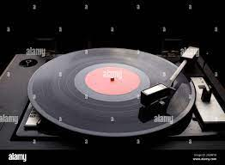
Model class- Player
Player class have following attributes
currentFrame- long datatype
filePath- String datatype
status- String datatype
clip- Clip

Slide 28
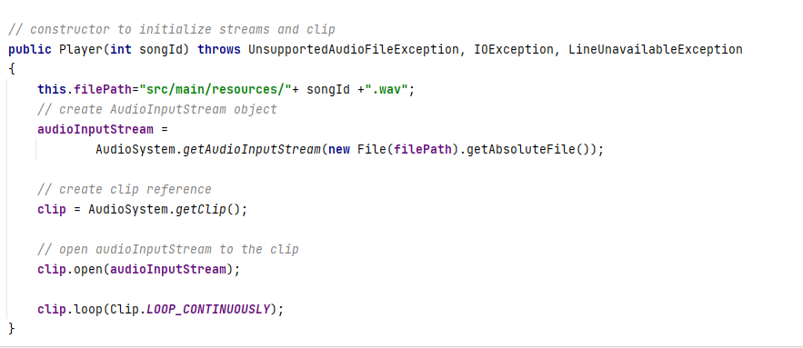
During creating the object of player class, we have to setup the player and define the filePath

Slide 29
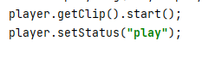
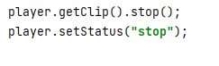
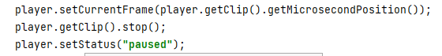
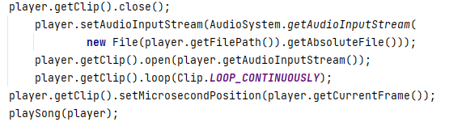
Play song
To play the song , we have to call the start() method of clip.
Stop song
To stop the song , we have to call the stop() method of clip.
Pause song
To pause the song , we have to set the currentFrame so that it can be used while resume the song and then call the stop() method of clip.
Resume song
To resume the song , we have to play the song again but set microPosition as current Frame. This will play the song from the position where it get stopped.

Slide 30

Play a playList
First, an ArrayList of songs of a playlist is required to play that playlist,
For this , we will call playlistContent() method and store the list in a new arrayList of Songs.
To play a playlist, we have to use a for loop in the list.
Create player object and pass songId.
This will create a player object
Next call player.play().
This will play song one by one.
To play next song, stop current song and use a break in switch case to finish current loop and play next song in the playlist.
This way we can switch the song in the playlist

Slide 31
ThankYou

